Slide 1
User Report
韩红雷
中国传媒大学 动画学院

Slide 2
本节内容
回顾以前知识
学习如何和SDK进行交互，得到可以用于游戏的信息
重点是以下内容：
  Contact Report
  Trigger Report
  Raycast Report

Slide 3
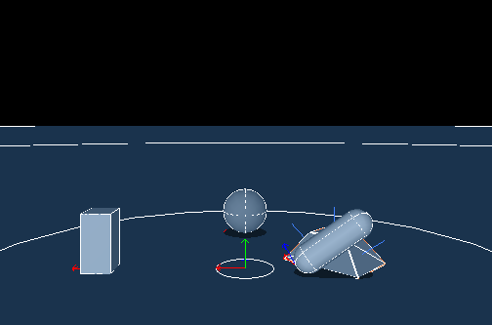
Debug Renderer

Slide 4
调试渲染器定义
调试渲染器可以帮助我们将物理场景可视化
每一桢结束，SDK都将和仿真相关的点、线和三角形组织起来进行绘制
这些信息保存在 “可以渲染的调试”结构中
这个渲染器只是为了调试目的
在发布版中，没必要浪费额外的时间来在每一帧构造可视化调试信息
Notes:
The debug renderer allows us to visualize our physics scene. At the end of each frame of the simulation, the SDK constructs relevant points, lines, and triangles of the simulation to be drawn. It stores these in its "debug renderable" structure. This renderer is for debug purposes only. In release mode, you don't want the SDK to spend extra time building the debug visuals at the end of each frame of simulation.

Slide 5
仿真过程
当我们绘制充满纹理、灯光等信息的场景时，我们同时也在进行物理仿真
首先让物理仿真完成，然后利用仿真结果绘制场景，同时进行下一帧物理计算
调试模式下，绘制线来作为衡量对象的外部位置和物理位置之间是否匹配
Notes:
When we draw our scene fully textured, lit, etc., we draw it in parallel with our physics simulation. We let the physics run to completion, get the results for the frame, then draw the results while we are process the next frame of the simulation. The debug render lines serve as a good check to see how well the visual representation of our objects matches their physical representation.

Slide 6
如何得到并显示调试信息
DebugRenderer类中有renderData(const NxDebugRenderable& data) 函数
该函数通过读取SDK提供的data信息来将物体的形状绘制出来，这个形状是物体最真实的形状

Slide 7

Visualization Parameters
要进行可视化，必须将NX_VISUALIZATION_SCALE设置为非零值
Notes:
To see any visualization, you need to set NX_VISUALIZATION_SCALE to a non-zero value first

Slide 8
练习（15分钟）
使用debug信息来确定绘制和物理状态是否统一

Slide 9
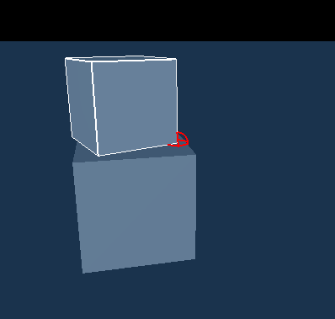
Contact Report

Slide 10
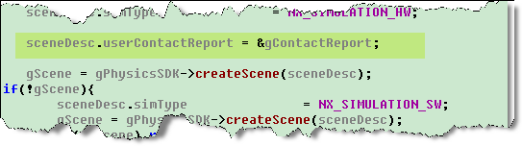
注册碰撞响应函数
我们在工程中添加一个头文件： ContactReport.h
构造了一个类ContactReport，继承自NxUserContactReport
在InitNx函数的构造scene阶段添加：
Notes:
We have added a new file to the project, ContactReport.h. This file contains a class called ContactReport which is derived from NxUserContactReport. We make an instance of this class which we attached to the SDK in InitNx().

Slide 11
步骤
define a callback function by subclassing PxSimulationEventCallback
  Not all of its member functions have to be implemented, only the ones to be overwritten
sceneDesc.filterShader

Slide 12
关键
通过以下的方式来将两个物体设置为可碰撞对
这样，当二者发生碰撞，我们就可以得到信息
当发生碰撞时，onContactNotify() 函数将被调用
  不管是刚发生碰撞还是正在碰撞阶段还是已经碰撞完
Notes:
At the end of InitNx() we call gScene->setActorPairFlags() on the two actors to make them into a contact pair. We will get information on every contact pair we have set up this way every simulation step that they are in contact. When they are in contact, onContactNotify() in ContactReport.h is called, passing in a reference to the contact pair and the nature of the contact, whether the pair just started touching, whether they've been touching, or whether they have stopped touching, set up in setActorPairFlags() by the NX_NOTIFY_ON_START_TOUCH, NX_NOTIFY_ON_TOUCH, and NX_NOTIFY_ON_END_TOUCH flags.

Slide 13
本小节需要掌握
如何将NxUserContactReport关联到SDK中来处理碰撞对
怎么样将两个actor设置为碰撞对并且为他们设置特殊的碰撞信息
如何使用碰撞流来得到碰撞对中两个actor发生碰撞的shape、面和点
Notes:
how to attach an NxUserContactReport to the SDK to get information on contact pairs, how to make two actors into contact pair and flag them for particular contact information, how to use the contact stream iterator to get shapes, faces, and points of contact between two actors in a contact pair.

Slide 14
练习（30分钟）
捕获碰撞事件
对碰撞事件做出反应
  在碰撞点处生成一个actor
  爆炸效果

Slide 15
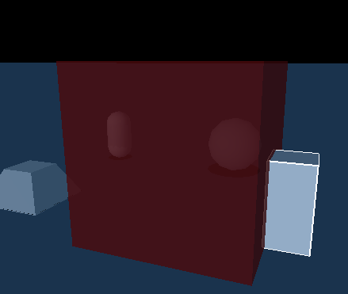
Trigger Report
Notes:
跟contact的区别是前者碰撞触发，不能穿透；而trigger是可以穿透的，可以认为是定义了一个区域。

Slide 16
定义
什么是Trigger（触发器）
  是Shape
  用于当其他物体和它发生冲突的时候触发特定事件
通过在shape描述符中设置NX_TRIGGER_ENABLE标志来得到触发器
必须将一个Trigger Report链接到scene中
当冲突发生的时候，Trigger Report在每帧都会调用onTrigger()
Notes:
In this lesson you will learn about triggers. Triggers are shapes used in games to cue events when particular objects intersect them. Trigger shapes are created by setting the NX_TRIGGER_ENABLE flag on the shape descriptor. For these shapes to work as triggers with code you supply, you need to attach a Trigger Report to the scene. A Trigger Report is a class derived from NxUserTriggerReport. This Trigger Report will call onTrigger() every frame the trigger is intersected by another shape, passing in a pointer to the trigger shape, the intersecting shape, and the state of the intersection, whether the intersecting shape has just entered the trigger, whether it has just left the trigger, or whether it has been inside the trigger for more than one frame.

Slide 17
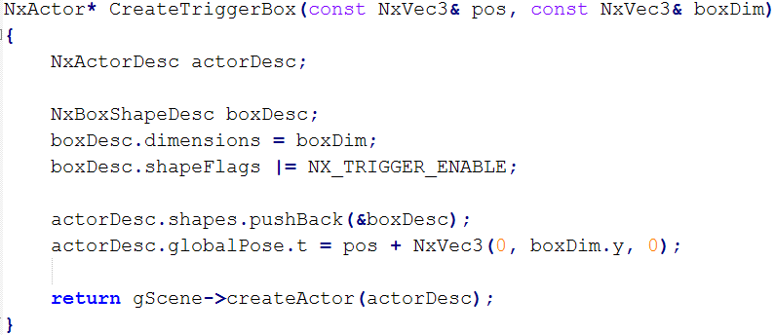
构造触发器

Slide 18
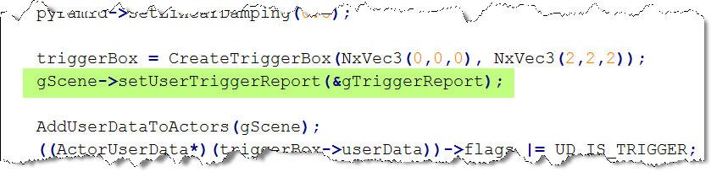
设置触发器响应对象

Slide 19
思考并练习（20分钟）
如何实现悬浮效果？
  物体进入触发器，触发响应函数
  响应函数中对进入的物体userdata进行更改
  程序循环时判断每个物体的userdata
  如果userdata为特定值，则对该物体施加力
游戏中有哪些应用？

Slide 20
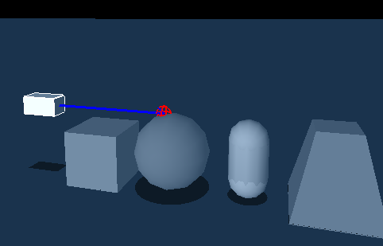
Raycast Report

Slide 21
什么是线投射
发射一个光线或者一条线到场景中
从线投射中我们可以得到以下信息：
  击中了什么shape
  从发射点到击中的shape距离
  线击中点信息
  Shape上击中点的法线
  如果击中的是三角形网格，可以击中三角形
Notes:
Now we move on to the concept of raycasting. Raycasting involves shooting a ray, a line emanating from a source, through the scene. The information we get from the raycast includes what shape we hit, how far away the shape is from the origin of the ray, the point of impact of the ray, the normal to the impact on the shape, and, if the shape hit is a triangle mesh, the surface triangle hit and the barycentric coordinates of the point of impact.

Slide 22
用处
判断物体的距离
判断哪个物体最近或者物体的哪个部分最近
判断哪些物体对于玩家来说是可见的
用在AI中，检测目标、导航，或者寻找感兴趣的物品
也可以用于阴影和光照计算
Notes:
Raycasting is useful for determining distances to objects as well as detecting which objects are closest and what features of the object are closest. It is used in visibility determination to calculate what objects in the scene are visible to the player. It is used in AI to detect targets, navigate the AI through environments, find cover positions, and sense other items of interest. It is also used for shadow and lighting calculations.

Slide 23
发射光线函数

Slide 24
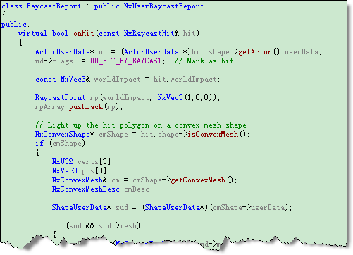
投射线响应函数

Slide 25
练习（20分钟）
掌握线投射的原理及应用

Slide 26
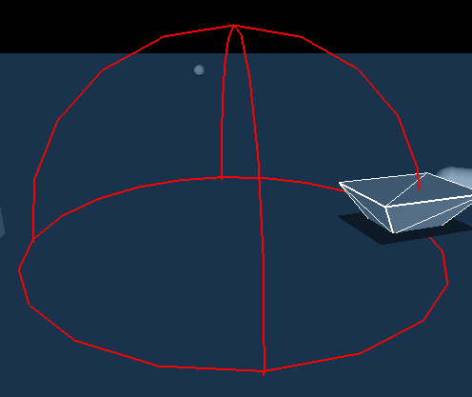
Entity Report
Notes:
PhysX has a wide array of standalone intersection tests you can use to determine whether a shape or triangles lie within a particular region of the scene.

Slide 27
流程
指定感兴趣的区域及碰撞形状
使用对应的碰撞检测方法来判断那些actor在指定的区域内
得到区域内的actor信息

Slide 28
综合练习（30分钟）
和计算机互动
  碰撞以后给与用户反馈
事件驱动
  如何让计算机知道事件的发生
  对这个事件进行处理
利用射线得到想要的信息

